Slide 1
Cars365
First man, then machine
Gowtham T (19z214)
Indra Shekar G (19z219)
Sanjai M(19z241)
Soumen Saha (19z245)
Manoj S (19z263)
Mathana Sekaran T (19z264)

Slide 2


Table of Contents
Introduction
Problem state
System Req
01
02
03
Req Gathering
Objective
Design
04
05
06
Here, we give a brief note on area of project
Here, we will discuss about why we took this project
Here, we will discuss on software and hardware reqs
Here, we will say about the modules we have used
Here, we will explain what we have worked on
Here, we explain the use case and system architecture

Slide 3

Introduction
The purpose of the cars365 online platform is to ease car trading and to create a convenient and easy-to-use application for car buyers and sellers. The system is based on a database with its buy, sell, rental and price prediction functions. It is consumer focused services that include content and tools for research, pricing, and marketplace information. Cars365 offers a platform where car buyers and owners can research, buy, sell and discuss cars.. Above all, we hope to provide a comfortable user experience along with convincing price predictions available.

Slide 4

Problem Statement

Slide 5
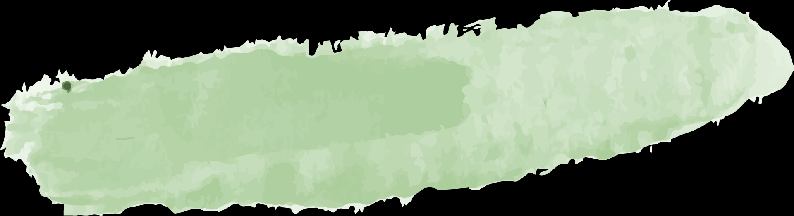



System Requirements
04
Back-End
Node JS
03
Front-End
Html, CSS, JavaScript
02
Software
Any Browser which can browse through internet
01
Hardware
Any Pc configuration which can connect to Internet

Slide 6

Requirements Gathering
Bootstrap
Frontend Frameworks and modules used
Bootstrap includes HTML and CSS based design templates for typography, forms, buttons, tables, navigation, models, images carousels and many other, as well as optional JavaScript plugins
jQuery
jQuery is a fast, small, and feature-rich JavaScript library. It makes things like HTML document traversal and manipulation, event handling, animation simpler with an easy-to-use API that works across all the browsers

Slide 7
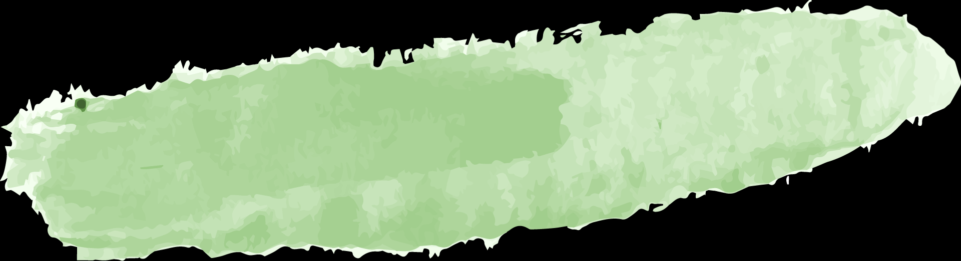

Express
Ejs
Node Js
Mongoose
Multer
Express is a minimal and flexible Node.js web application framework that provides a robust set of features for web and mobile applications.
EJS (Embedded JavaScript) is a simple templating language that lets you generate HTML markup with plain JavaScript.
Mongoose is used to work with mongo dB database with very simple syntax and provides a straight-forward, schema-based solution to model your application data.
Multer is a node.js middleware for handling multipart/form-data, which is primarily used for uploading files.

Slide 8
Node Js
Body-Parser
This module Parses incoming request bodies in a middleware before your handlers. It can parse Json, Text and many other formats
Dotenv
Dotenv is a zero-dependency module that loads environment variables which contains sensitive information's like api keys or database connection links, Id’s etc.

Slide 9
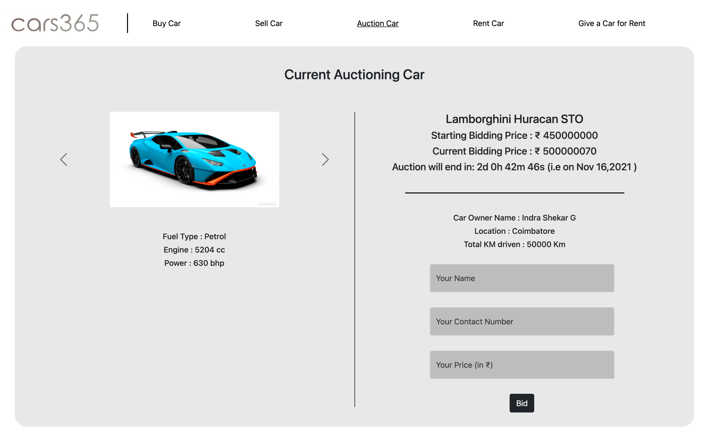
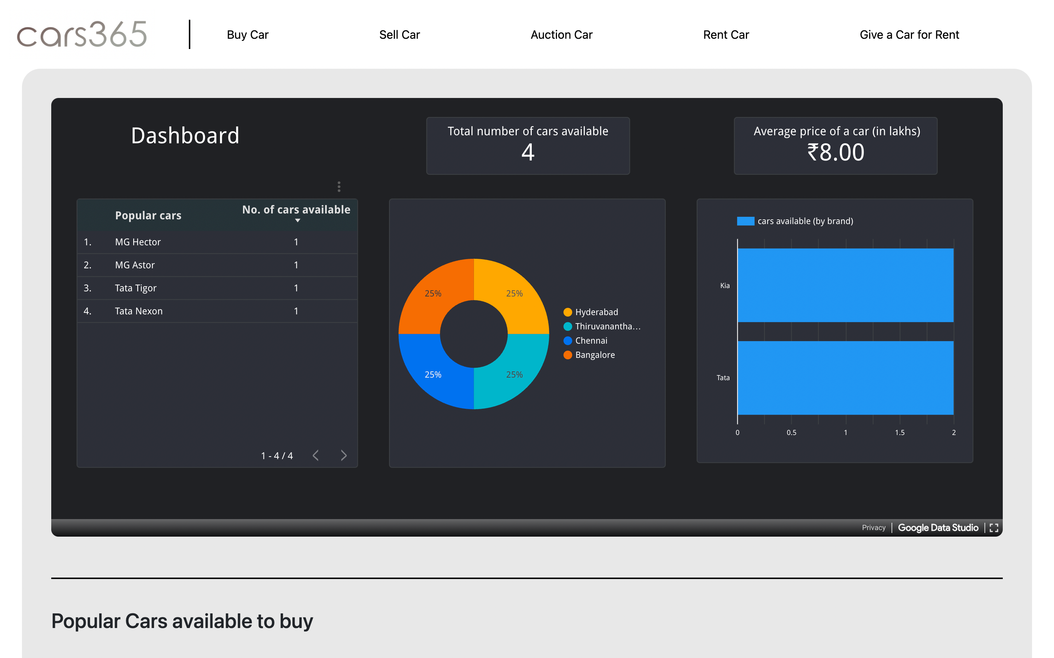
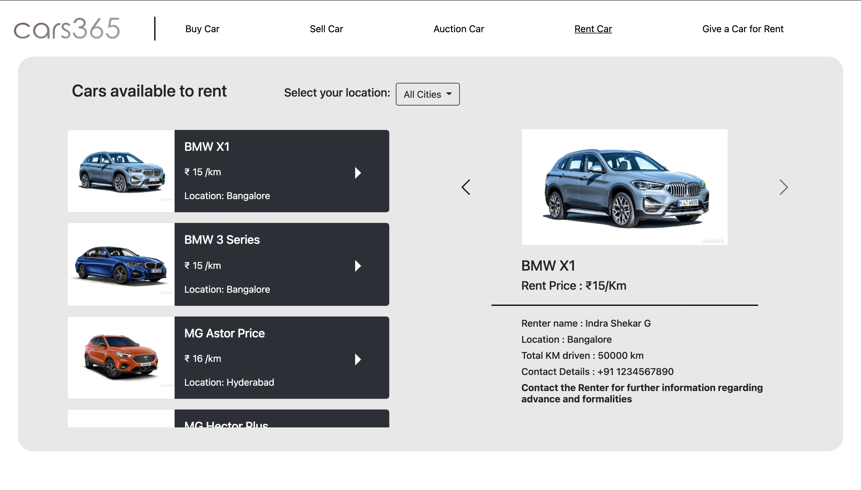
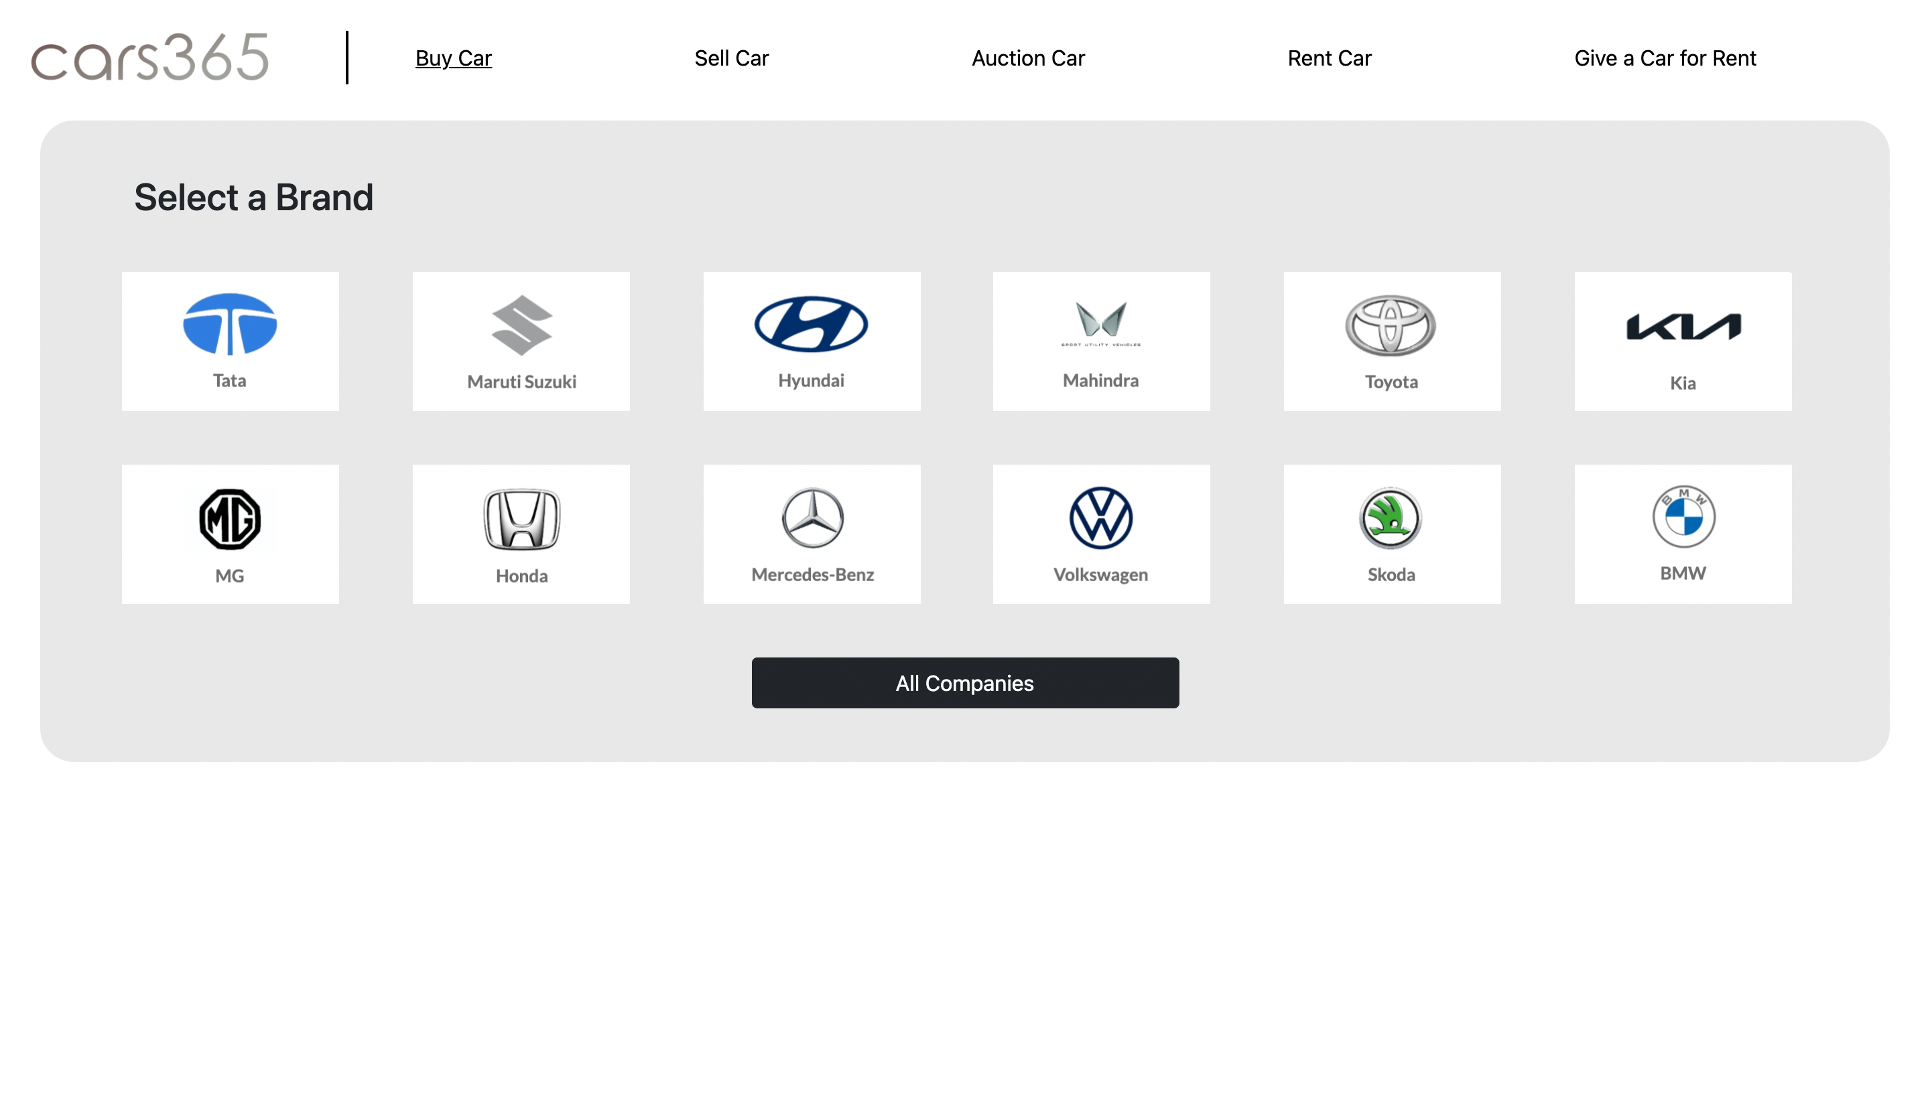
Sneak Peek

Slide 10

Objective

Slide 11
Design

Slide 12
Contribution

Slide 13
Thank you
Gowtham T (19z214)
Indra Shekar G (19z219)
Sanjai M(19z241)
Soumen Saha (19z245)
Manoj S (19z263)
Mathana Sekaran T (19z264)

